Slide 1
ANZ PREDICTIVE ANALYSIS
DELIVERED BY ANNE AWELE NWAOKOLO

Slide 2
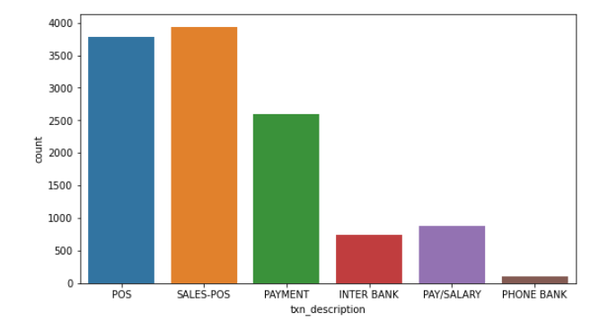
TRANSACTION DETAILS BY COUNT

Slide 3
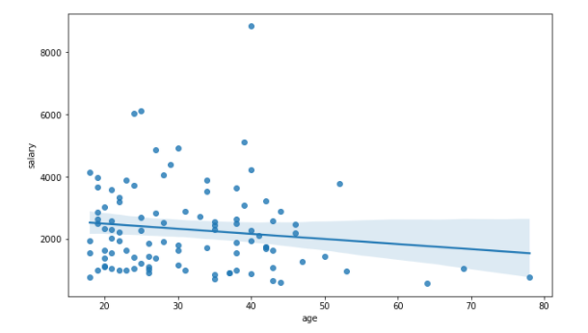
SALARY BY AGE

Slide 4
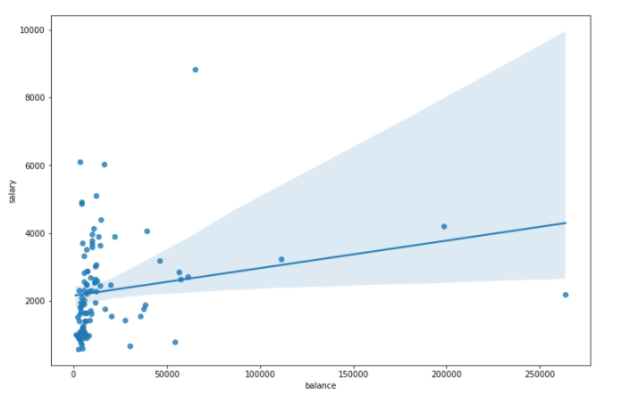
SALARY BY BALANCE

Slide 5
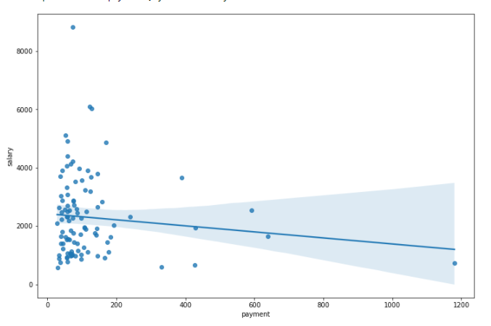
SALARY BY PAYMENT

Slide 6
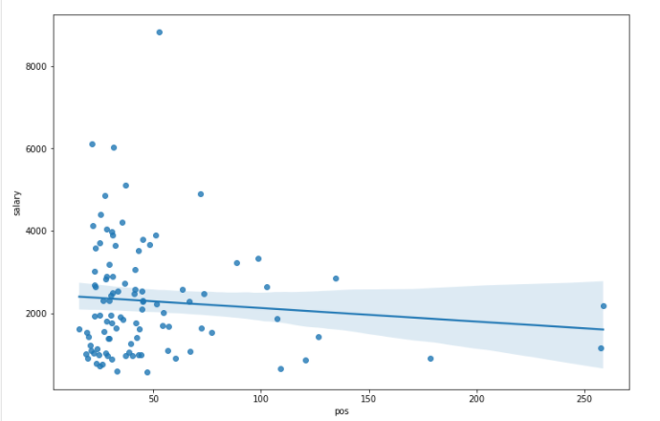
SALARY BY POS TRANSACTIONS

Slide 7
Conclusion
Using Linear Regression
Salary for customer age 50 with balance of $5000 Payment of $100 and Pos Transaction of $50 will be $1694
for customer age 60 with balance of $5000 Payment of $100 and Pos Transaction of $50 will be $1694
Using Decision Tree Regression
Salary for customer age 50 with balance of $5000 Payment of $100 and Pos Transaction of $50 will be $1272
for customer age 60 with balance of $5000 Payment of $100 and Pos Transaction of $50 will be $1043.

